Slide 1
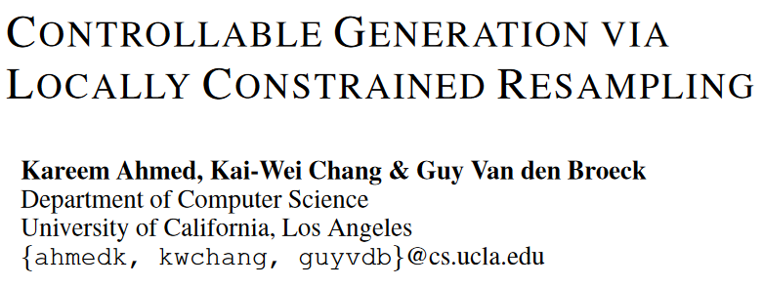
ICLR 2025 (poster)

Slide 2
Abstract
LMs struggle with generating complex outputs that adhere to logical constraints.
We propose a tractable probabilistic approach that performs Bayesian conditioning to draw samples subject to a constraint.
Starting from a model sample, we induce a local, factorized distribution which we can tractably condition on the constraint, and then resample.
We evaluate our approach on LLM detoxification and solving Sudoku puzzles.
By disallowing a list of toxic expressions, our approach is able to steer the model’s outputs away from toxic generations, outperforming similar approaches to detoxification.

Slide 3
Introduction
LLMs struggle with generating complex sequences that adhere to logical constraints.
Existing approaches: at each generation step, greedily mask the LLM outputs that could lead to constraint violation.
Limitations:
Myopic. The constraint is enforced greedily on a per-token basis. However, in Bayesian conditioning, we consider the whole sequence.
The constraint specification language is typically regular expressions, which is more verbose than equivalent DFAs.
Some class of constraint functions can only be described by DFAs whose size grows exponentially in the size of their constraint.

Slide 4
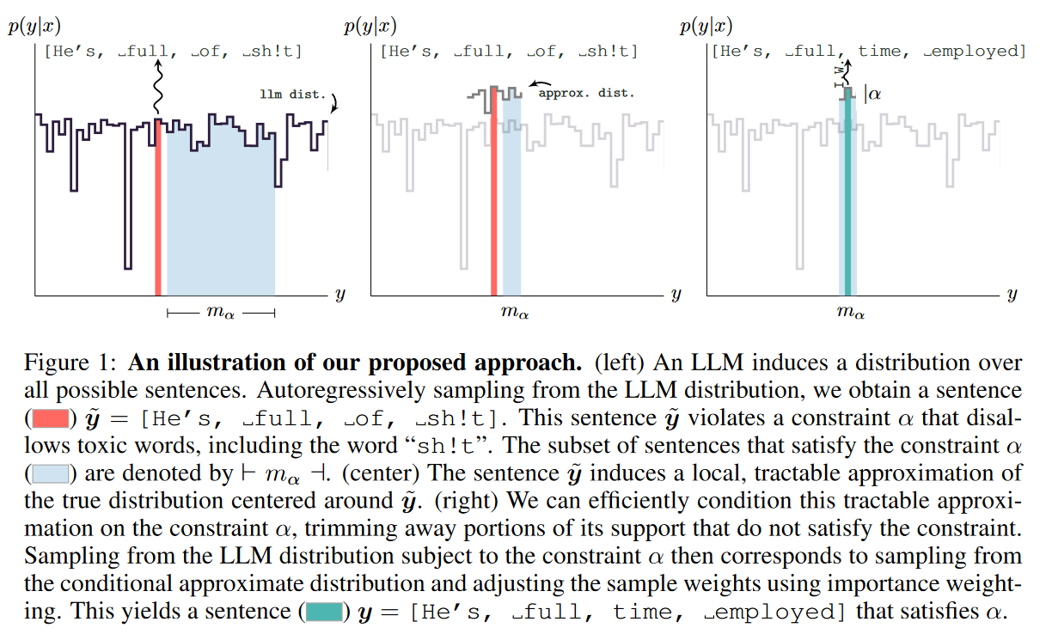
Introduction

Slide 5
Introduction
We observe that an LLM sample induces a local, factorized distribution.
We use constraint circuits as our constrain, which subsume DFAs on bounded-length strings while being more expressive efficient.
Such constrain can be specified as Boolean python functions.
We can use logical circuits to tractably condition on that distribution, drawing samples that are biased but provably satisfy the constraint.
We can then debias the result by reweighting them proportionally to their LLM probability and resampling.
Such samples are distributed according to the conditional LLM distribution while satisfying the constraint.

Slide 6
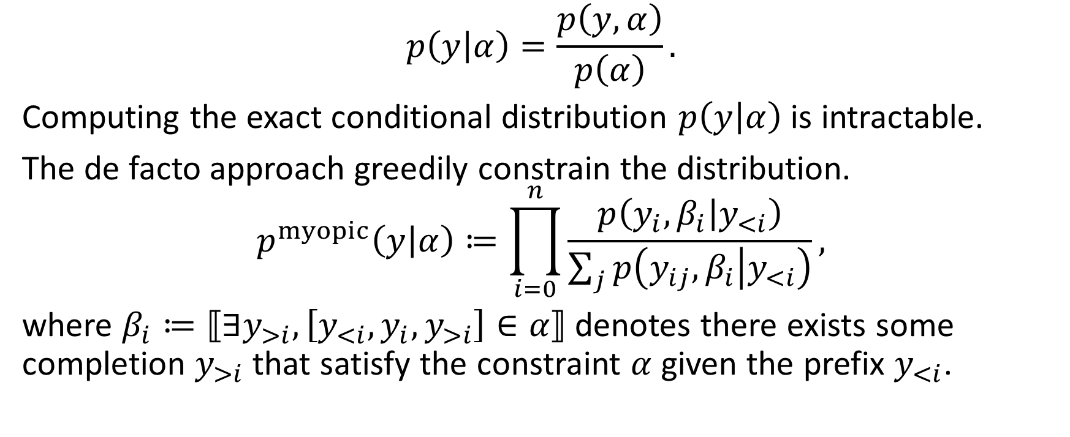
Background
$$p\left(y | α\right)=\frac{p\left(y, α\right)}{p\left(α\right)}.$$
Computing the exact conditional distribution $p\left(y | α\right)$ is intractable.
The de facto approach greedily constrain the distribution.
$$p^{myopic}\left(y | α\right)≔\prod_{i=0}^{n}{\frac{p\left(y_{i},β_{i} | y_{<i}\right)}{\sum_{j}{p\left(y_{ij},β_{i} | y_{<i}\right)}}},$$
where $β_{i}≔⟦∃y_{>i}, \left[y_{<i},y_{i},y_{>i}\right]∈α⟧$ denotes there exists some completion $y_{>i}$ that satisfy the constraint $α$ given the prefix $y_{<i}$.

Slide 7
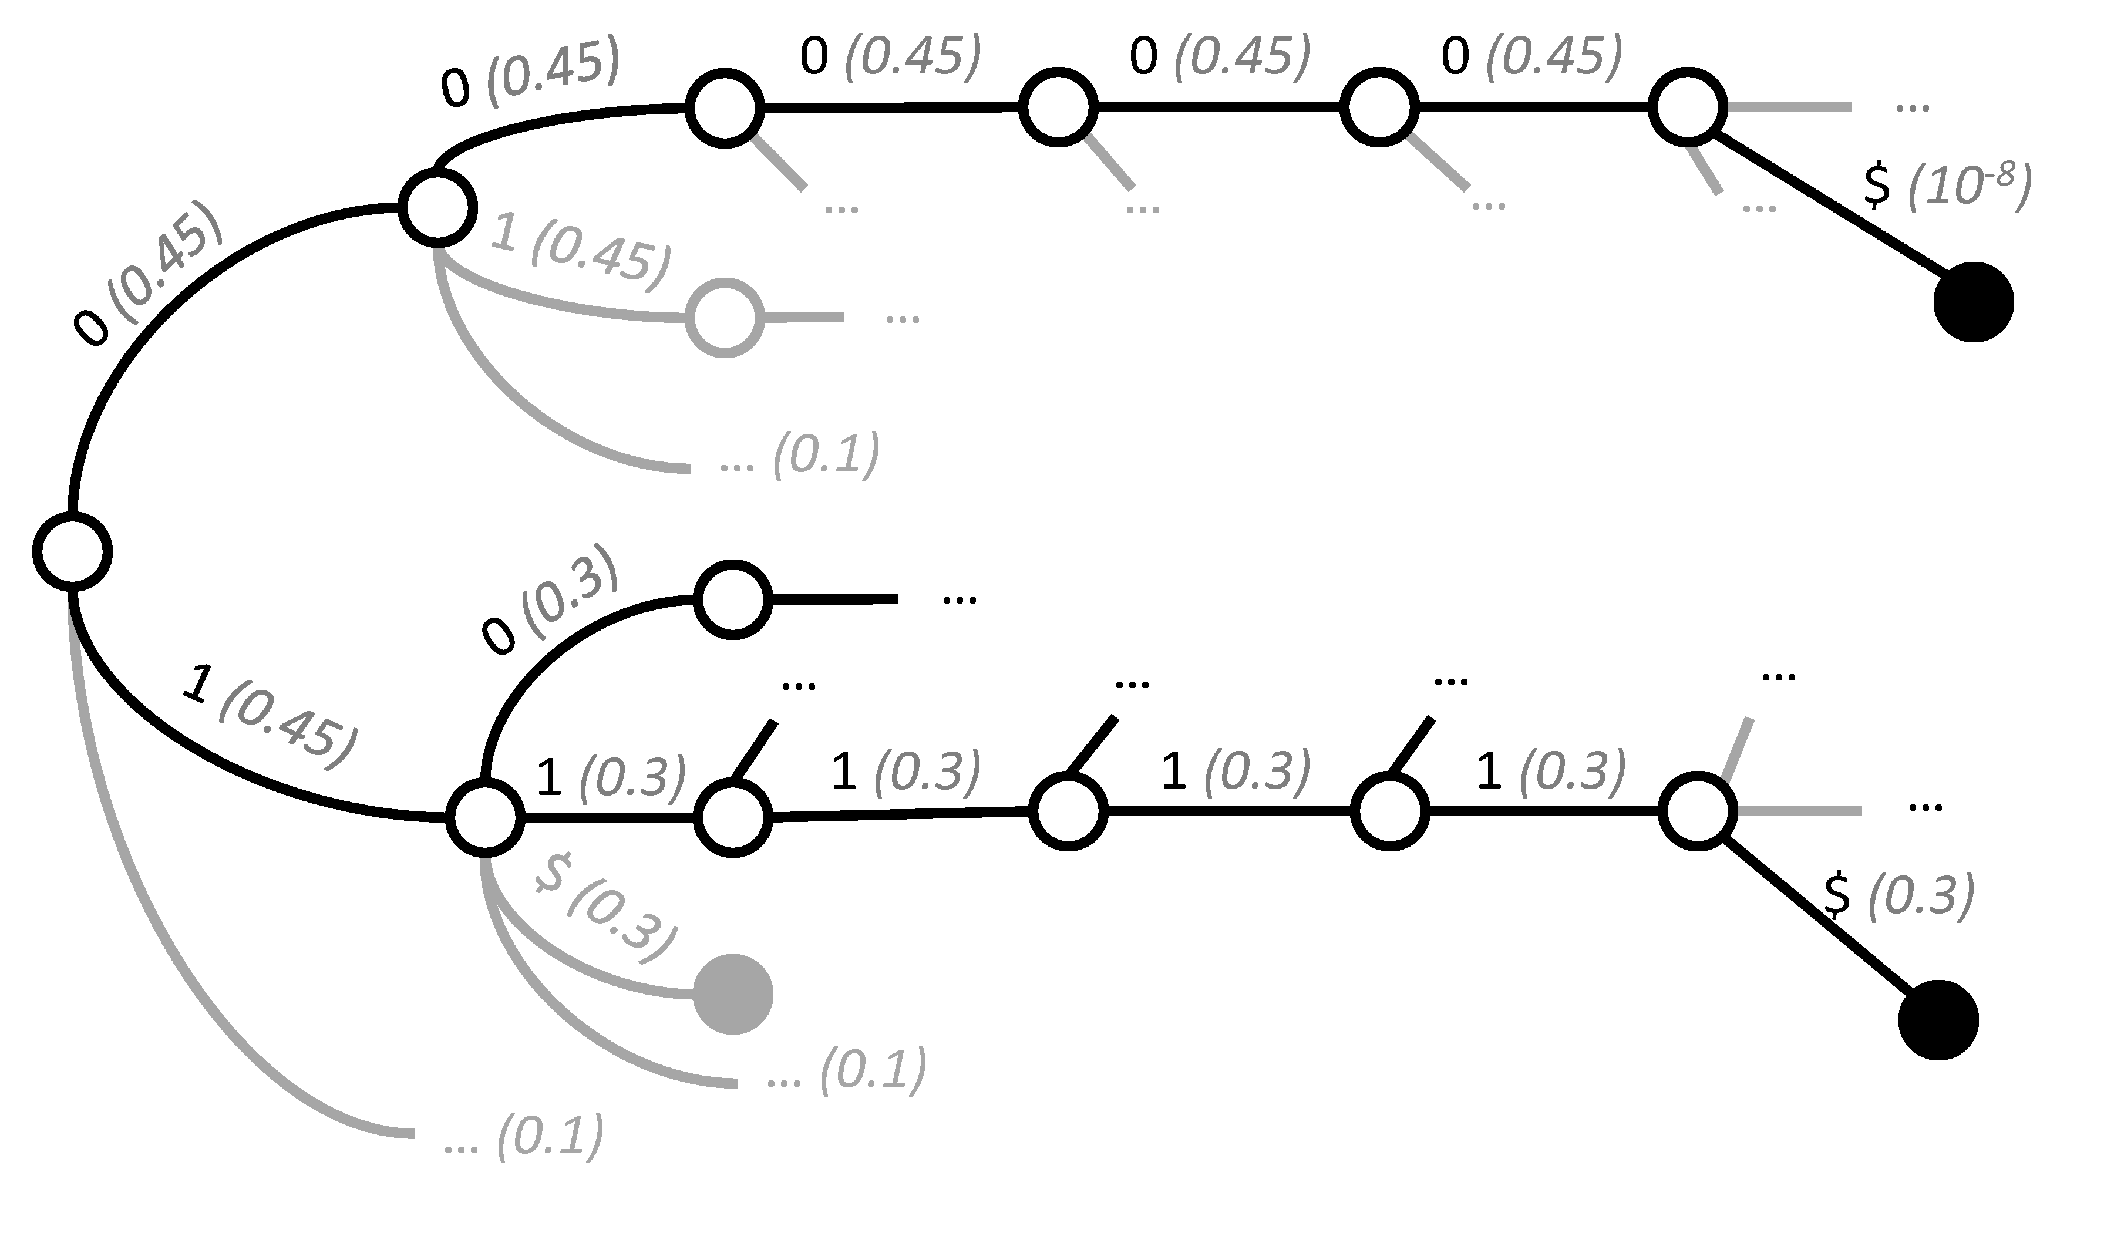
Problem of GCD
Problem GCD distorts the LLM's learned language distribution.
Example
Grammar: 00000|1[01]{4}
Prompt: generate a binary string that ends with a 1
Expected: high prob to 1xxx1; low prob to 00000; zero prob to any other string.
GCD: Only 30% output ends with 1.

Slide 8
Background
Second issue: The current specification language is too verbose.
Mostly used constraint is regular expressions, which is significantly more verbose than equivalent logical form.
The lack of succinctness of the target representation: all current approaches compile the specified regular expression into DFAs. But the size of DFA can grow prohibitively.
It turns out we can branch on the value of an entire sentence. We henceforth denote them as constraint circuits (old research).

Slide 9
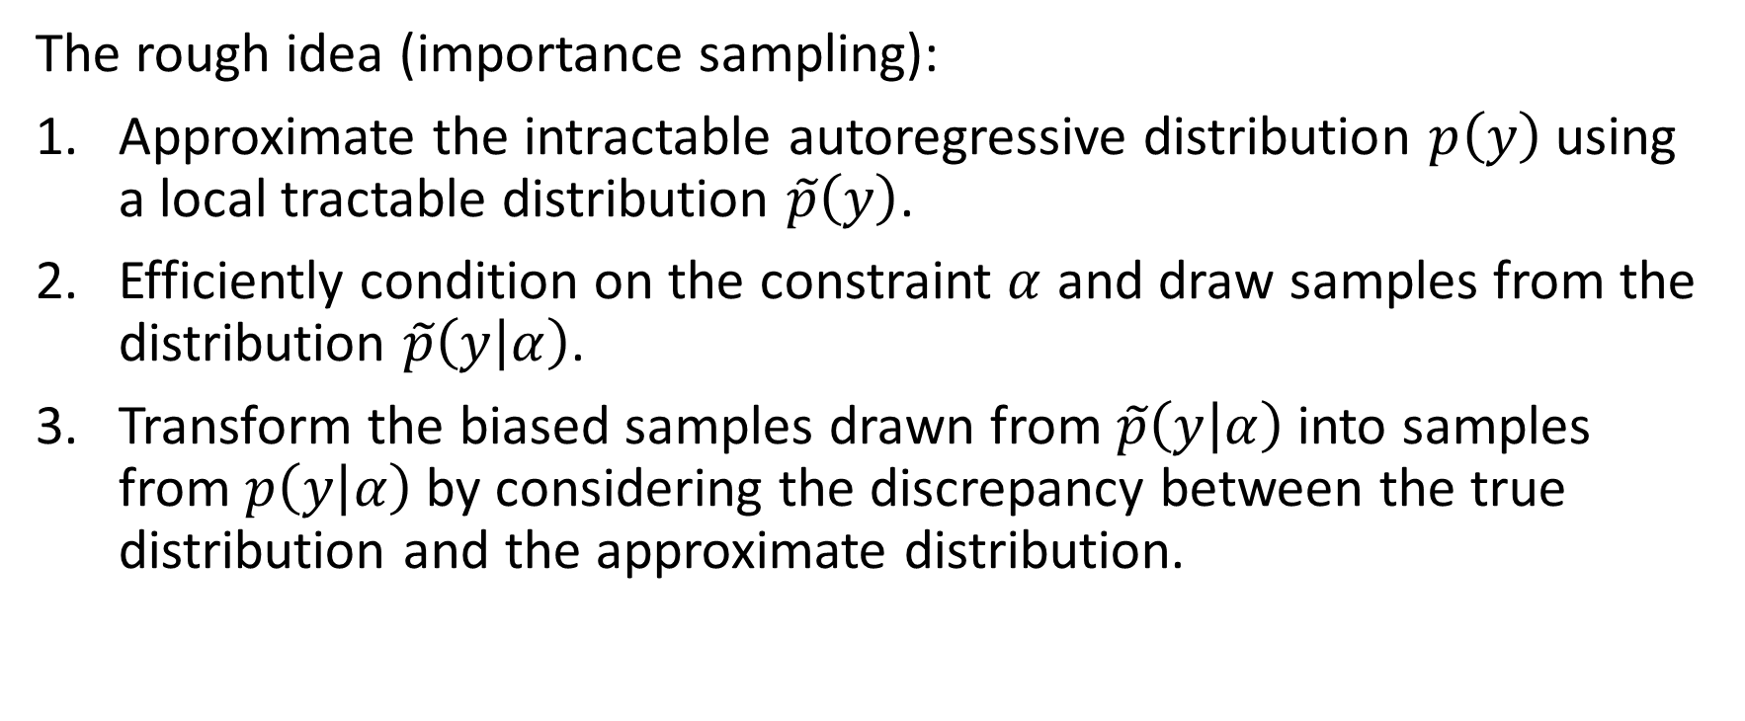
Locally Constrained Resampling
The rough idea (importance sampling):
Approximate the intractable autoregressive distribution $p\left(y\right)$ using a local tractable distribution $\tilde{p}\left(y\right)$.
Efficiently condition on the constraint $α$ and draw samples from the distribution $\tilde{p}\left(y | α\right)$.
Transform the biased samples drawn from $\tilde{p}\left(y | α\right)$ into samples from $p\left(y | α\right)$ by considering the discrepancy between the true distribution and the approximate distribution.

Slide 10
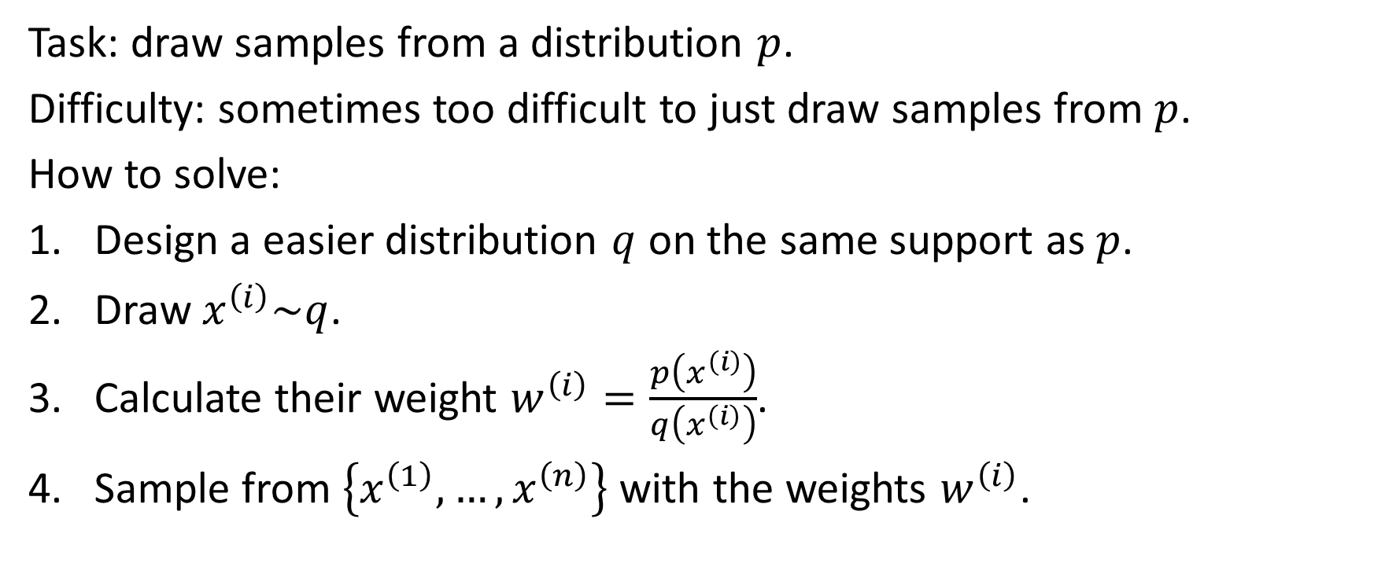
Importance sampling
Task: draw samples from a distribution $p$.
Difficulty: sometimes too difficult to just draw samples from $p$.
How to solve:
Design a easier distribution $q$ on the same support as $p$.
Draw $x^{\left(i\right)}\sim q$.
Calculate their weight $w^{\left(i\right)}=\frac{p\left(x^{\left(i\right)}\right)}{q\left(x^{\left(i\right)}\right)}$.
Sample from $\left\{x^{\left(1\right)},…,x^{\left(n\right)}\right\}$ with the weights $w^{\left(i\right)}$.

Slide 11
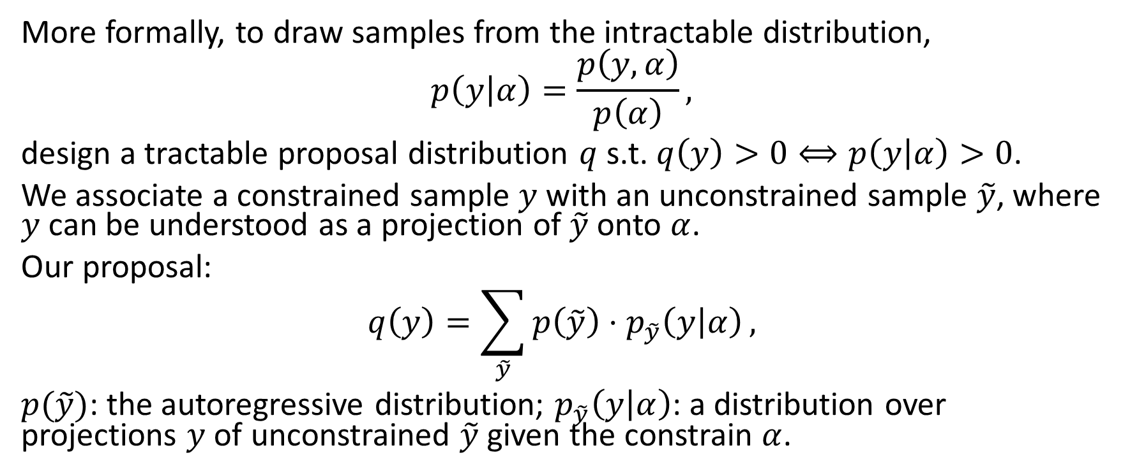
Locally Constrained Resampling
More formally, to draw samples from the intractable distribution,
$$p\left(y | α\right)=\frac{p\left(y, α\right)}{p\left(α\right)},$$
design a tractable proposal distribution $q$ s.t. $q\left(y\right)>0⟺p\left(y | α\right)>0$.
We associate a constrained sample $y$ with an unconstrained sample $\tilde{y}$, where $y$ can be understood as a projection of $\tilde{y}$ onto $α$.
Our proposal:
$$q\left(y\right)=\sum_{\tilde{y}}{p\left(\tilde{y}\right)⋅p_{\tilde{y}}\left(y | α\right)},$$
$p(\tilde{y})$: the autoregressive distribution; $p_{\tilde{y}}\left(y | α\right)$: a distribution over projections $y$ of unconstrained $\tilde{y}$ given the constrain $α$.

Slide 12
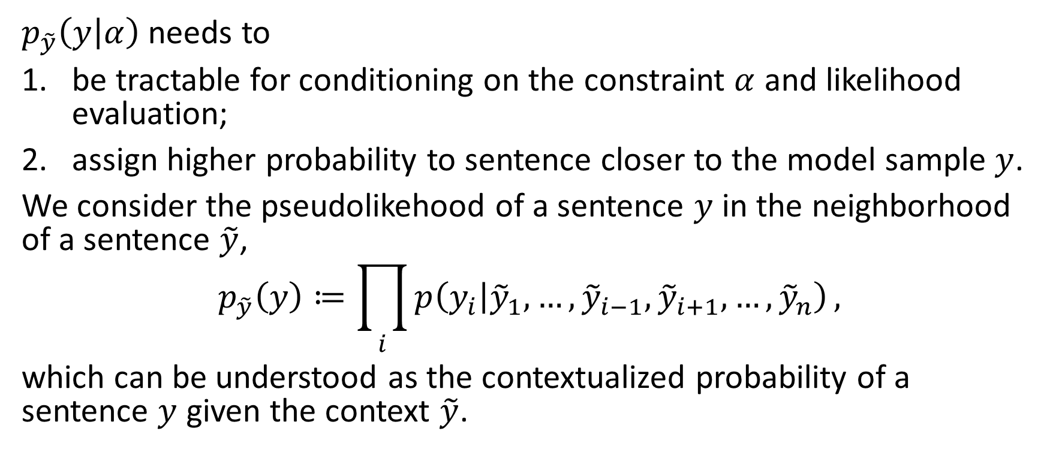
A Sample Induces a Local, Tractable distribution
$p_{\tilde{y}}\left(y | α\right)$ needs to
be tractable for conditioning on the constraint $α$ and likelihood evaluation;
assign higher probability to sentence closer to the model sample $y$.
We consider the pseudolikehood of a sentence $y$ in the neighborhood of a sentence $\tilde{y}$,
$$p_{\tilde{y}}\left(y\right)≔\prod_{i}{p\left(y_{i} | {\tilde{y}}_{1},…,{\tilde{y}}_{i−1},{\tilde{y}}_{i+1},…,{\tilde{y}}_{n}\right)},$$
which can be understood as the contextualized probability of a sentence $y$ given the context $\tilde{y}$.

Slide 13
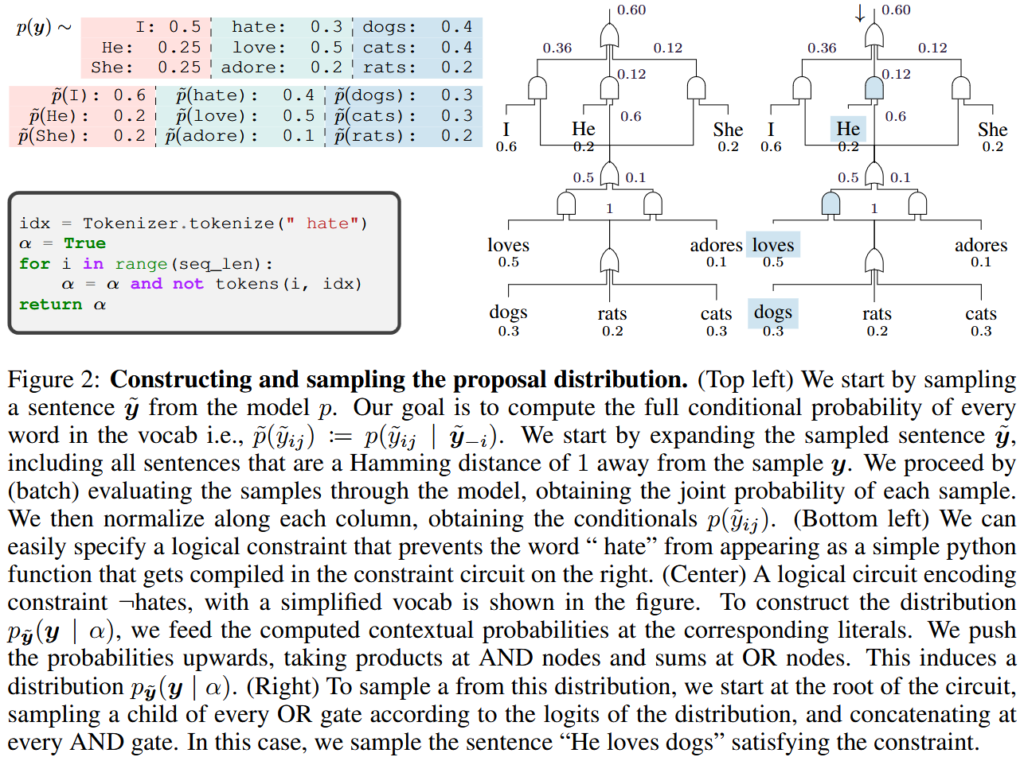

Constraint Compilation and Tractable Operations
Knowledge compilation: logical constraint $⇒$ tractable target form which represents functions as parameterized computational graphs.
We can enable tractable computation of certain classes of probabilistic queries over the encoded functions by enforcing certain structural properties on the compiled circuits.

Slide 14
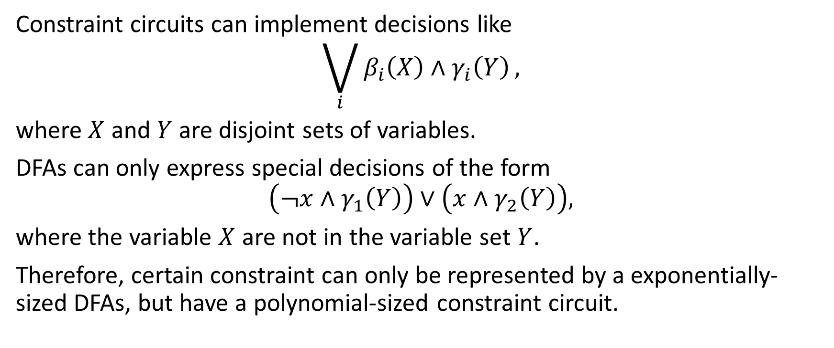
Constraint Circuits vs DFAs
Constraint circuits can implement decisions like
$$\bigvee_{i}{β_{i}\left(X\right)∧γ_{i}\left(Y\right)},$$
where $X$ and $Y$ are disjoint sets of variables.
DFAs can only express special decisions of the form
$$\left(¬x∧γ_{1}\left(Y\right)\right)∨\left(x∧γ_{2}\left(Y\right)\right),$$
where the variable $X$ are not in the variable set $Y$.
Therefore, certain constraint can only be represented by a exponentially-sized DFAs, but have a polynomial-sized constraint circuit.

Slide 15
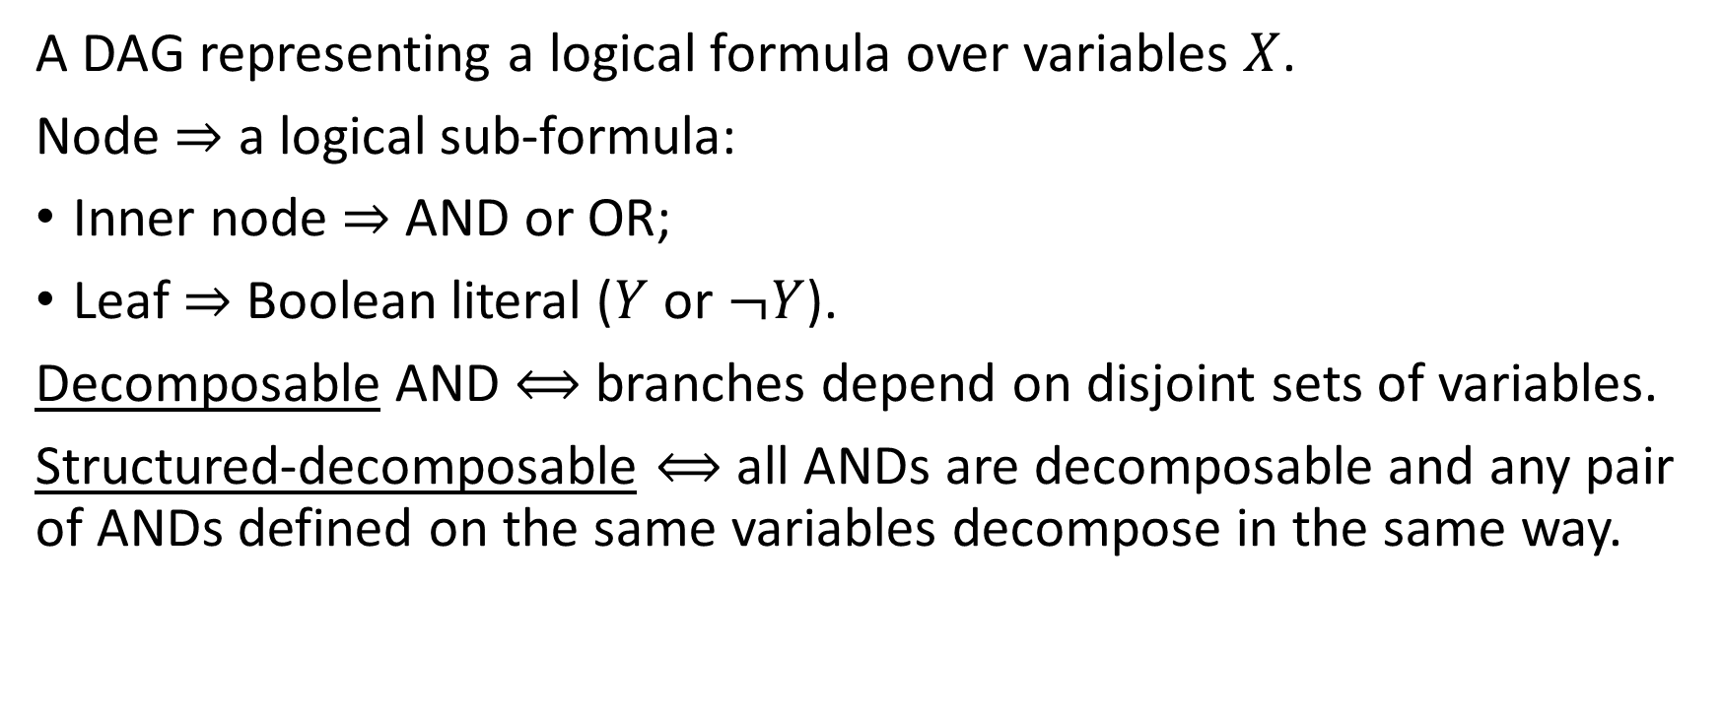
Logical Circuit
A DAG representing a logical formula over variables $X$.
Node $⇒$ a logical sub-formula:
Inner node $⇒$ AND or OR;
Leaf $⇒$ Boolean literal ($Y$ or $¬Y$).
Decomposable AND $⟺$ branches depend on disjoint sets of variables.
Structured-decomposable $⟺$ all ANDs are decomposable and any pair of ANDs defined on the same variables decompose in the same way.

Slide 16
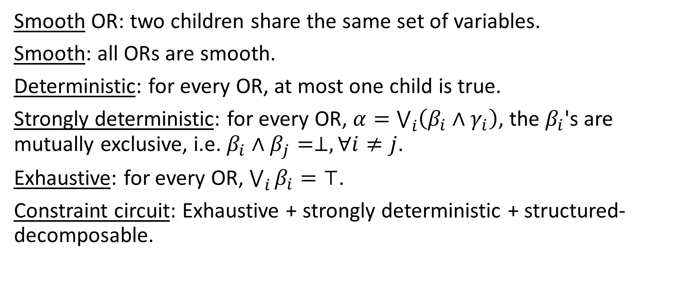
Logical Circuit
Smooth OR: two children share the same set of variables.
Smooth: all ORs are smooth.
Deterministic: for every OR, at most one child is true.
Strongly deterministic: for every OR, $α=\bigvee_{i}{\left(β_{i}∧γ_{i}\right)}$, the $β_{i}$'s are mutually exclusive, i.e. $β_{i}∧β_{j}=⊥, ∀i≠j$.
Exhaustive: for every OR, $\bigvee_{i}{β_{i}}=⊤$.
Constraint circuit: Exhaustive + strongly deterministic + structured-decomposable.

Slide 17
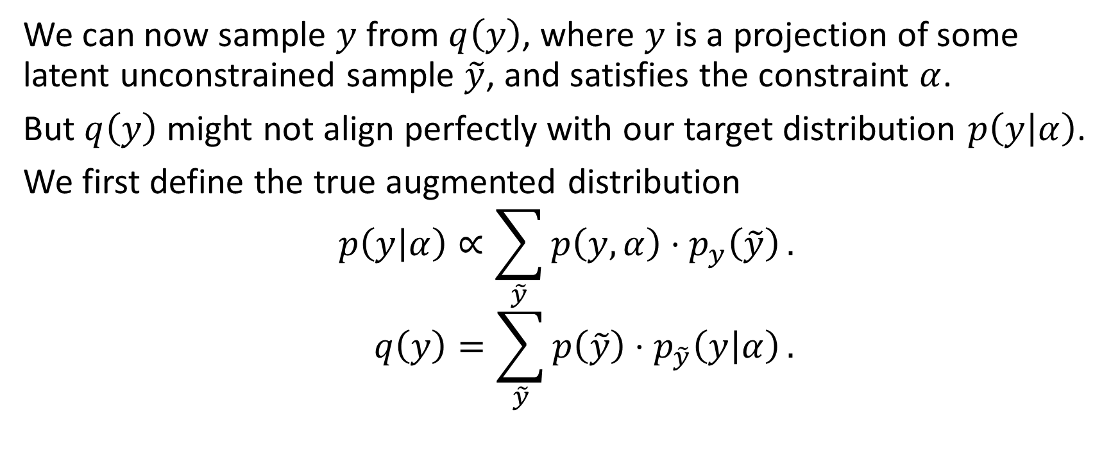
Importance Sampling ... Resampling
We can now sample $y$ from $q\left(y\right)$, where $y$ is a projection of some latent unconstrained sample $\tilde{y}$, and satisfies the constraint $α$.
But $q\left(y\right)$ might not align perfectly with our target distribution $p\left(y | α\right)$.
We first define the true augmented distribution
$$p\left(y | α\right)∝\sum_{\tilde{y}}{p\left(y,α\right)⋅p_{y}\left(\tilde{y}\right)}. \\ q\left(y\right)=\sum_{\tilde{y}}{p\left(\tilde{y}\right)⋅p_{\tilde{y}}\left(y | α\right)}.$$

Slide 18
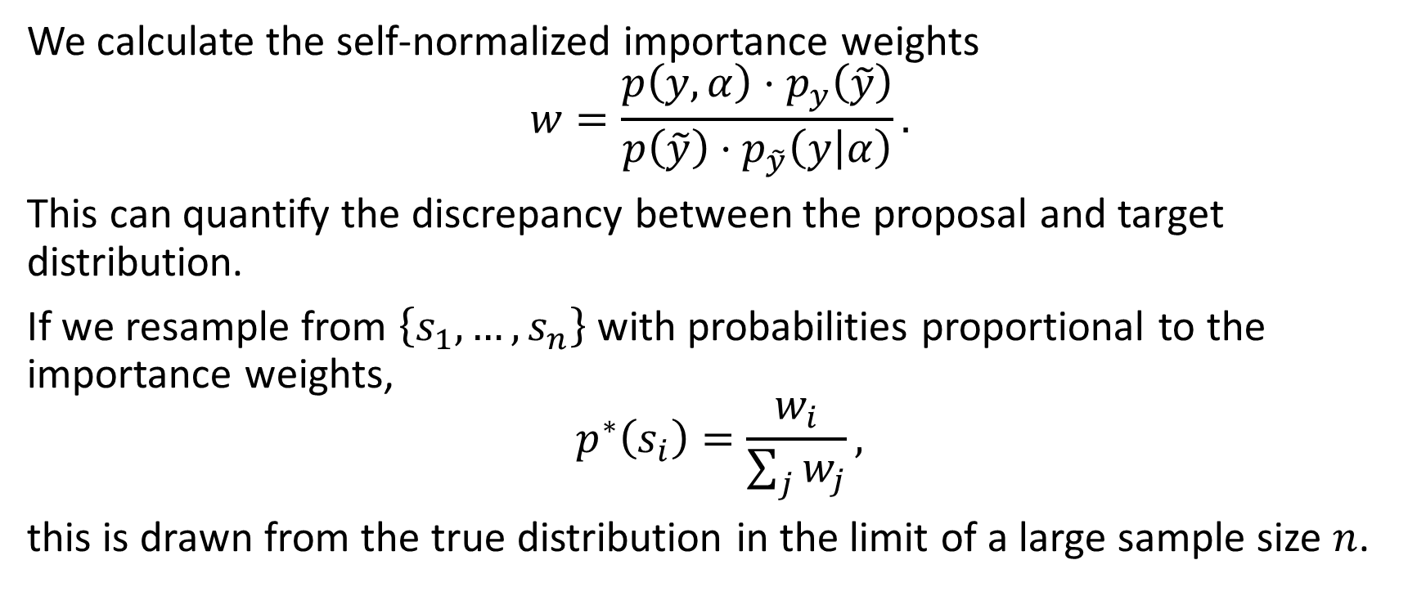
Importance Sampling ... Resampling
We calculate the self-normalized importance weights
$$w=\frac{p\left(y,α\right)⋅p_{y}\left(\tilde{y}\right)}{p\left(\tilde{y}\right)⋅p_{\tilde{y}}\left(y | α\right)}.$$
This can quantify the discrepancy between the proposal and target distribution.
If we resample from $\left\{s_{1},…,s_{n}\right\}$ with probabilities proportional to the importance weights,
$$p^{∗}\left(s_{i}\right)=\frac{w_{i}}{\sum_{j}{w_{j}}},$$
this is drawn from the true distribution in the limit of a large sample size $n$.

Slide 19
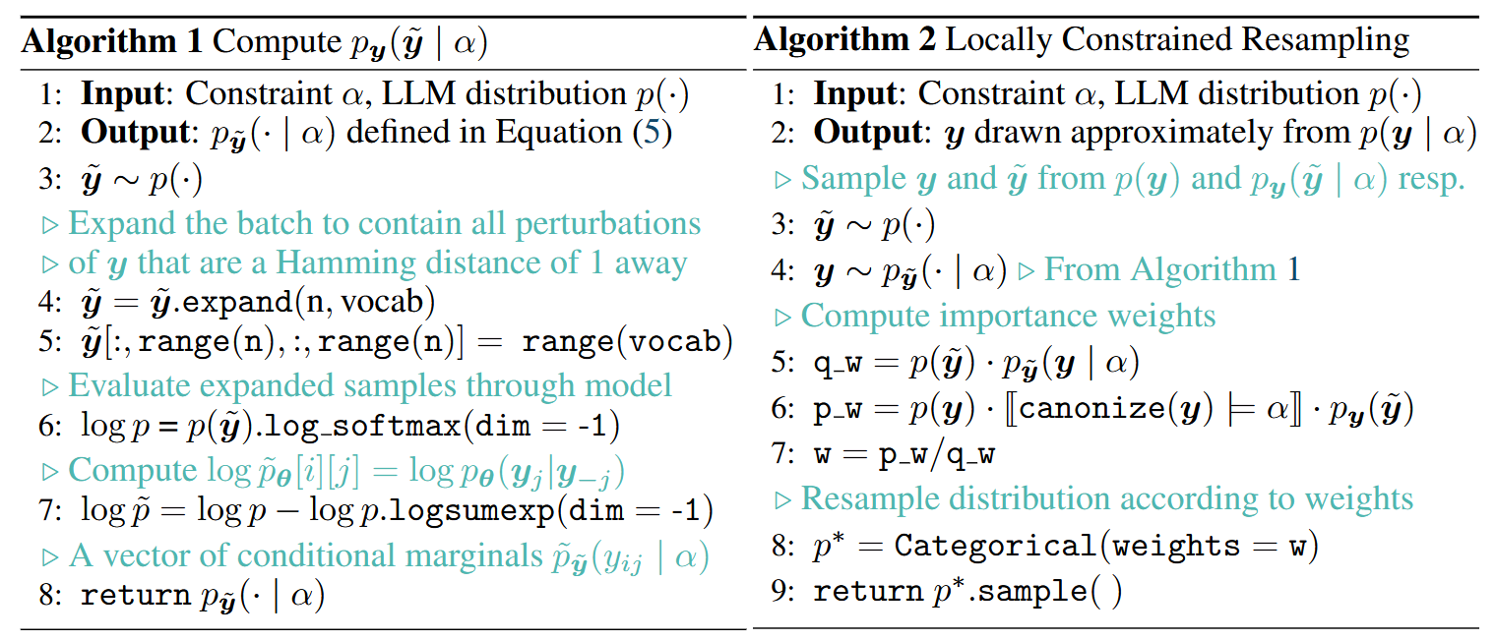
The whole algorithm

Slide 20
An example

Slide 21
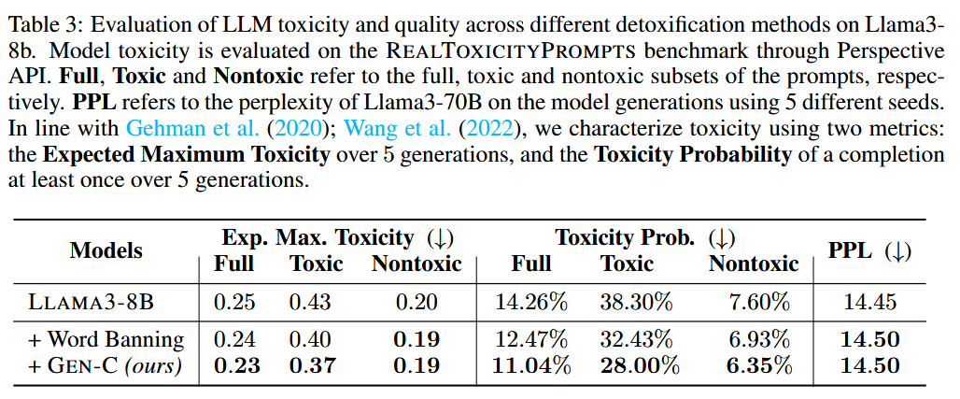
Experiments

Slide 22
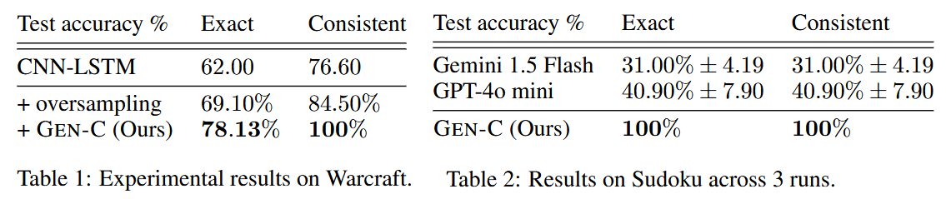
Other experiments
Warcraft shortest path: a model should output the shortest path in a warcraft map, and the output is autoregressively generated. Exact: it is a shortest path; consistent: it is a valid path.
Sudoku: predicting a solution to a given Sudoku puzzle (10 to fill). Train LLM to do this. (train: 9k, test: 1k).

Slide 23
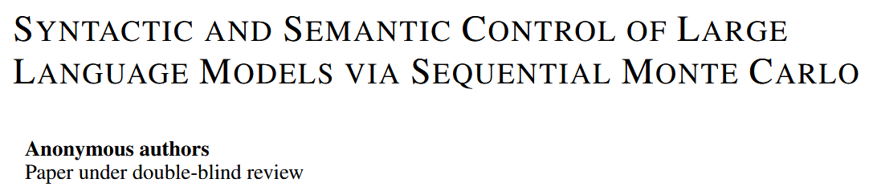
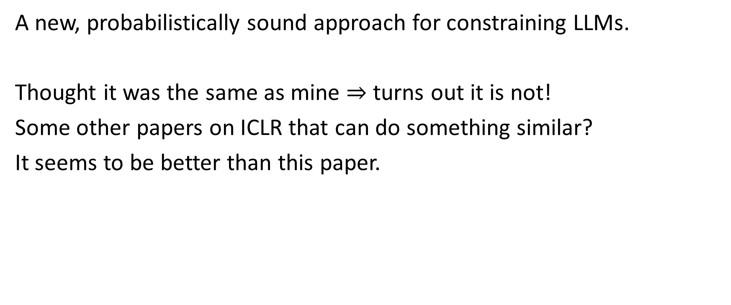
Conclusion
A new, probabilistically sound approach for constraining LLMs.
Thought it was the same as mine $⇒$ turns out it is not!
Some other papers on ICLR that can do something similar?
It seems to be better than this paper.

Slide 24
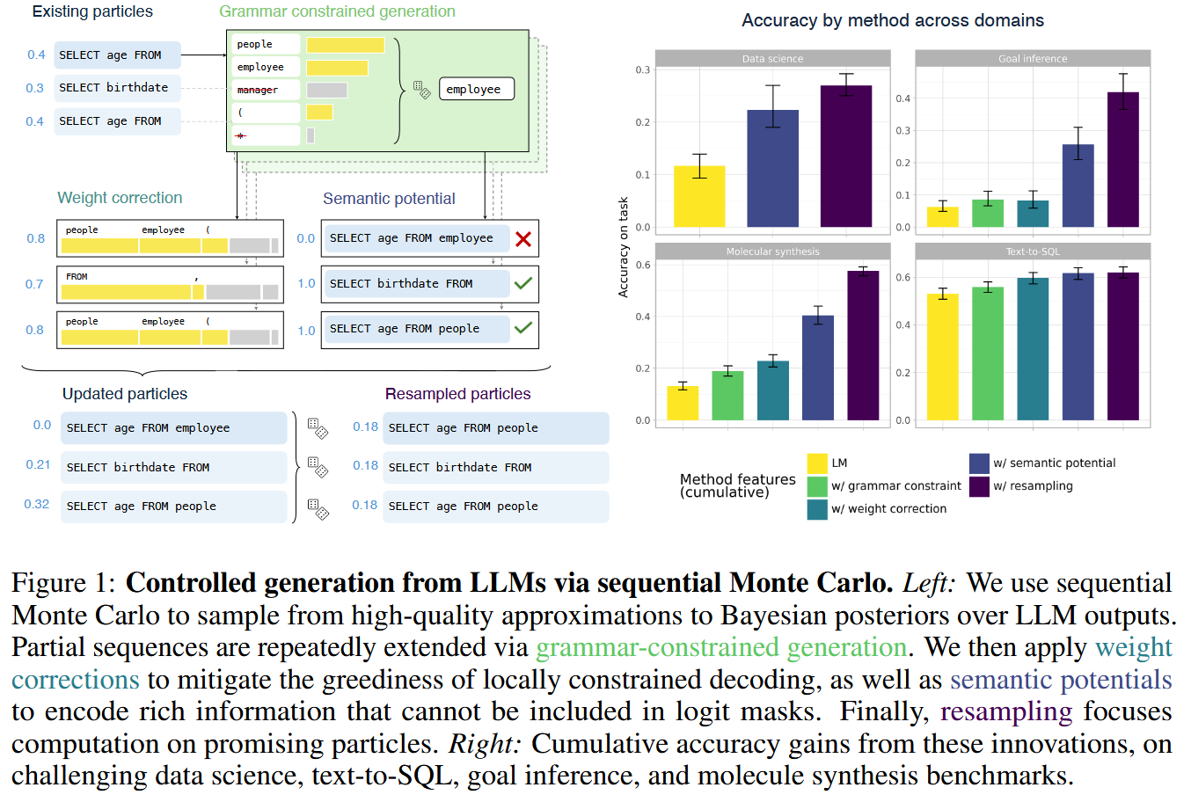
Syntactic and Semantic Control of Large Language Models via Sequential Monte Carlo

